Slide 1
Cafe and Restaurant Analysis, Bangalore
Mahesh Kumar Nayak

Slide 2
Why Bangalore Restaurants only ?
Restaurants from all over the world can be found here in Bengaluru.
From United States to Japan, Russia to Antarctica, you get all type of cuisines here. Delivery, Dine-out, Pubs, Bars, Drinks, Buffet, Desserts you name it and Bengaluru has it.
The number of restaurant are increasing day by day. Currently which stands at approximately 12,000 restaurants. With such a high number of restaurants. This industry hasn't been saturated yet.
This project aims at analysing demography, its food culture of the location. Most importantly it will help new restaurants in deciding their theme, menus, cuisine, cost etc for a particular location. It also aims at finding similarity between neighbourhoods of Bengaluru on the basis of food. With the analysis the project also will help people in choosing the restaurant based on several other factors. The project will mainly try to answer the quetion based on restaurants and foodies interest. And what factors should be kept in mind if someone wants to open new restaurant.

Slide 3
Data acquisition and cleaning
The main data used for this project were from two sources:
The restaurants in each neighbourhood scraped from the Zomato website.
Explore trending venues in a neighbourhood particularly restaurant (FourSquare API).
In total, 51,768 rows and 17 features in the raw dataset.
Duplicate, highly similar or highly correlated features were dropped.
Cleaned data contains 13000(approx) rows.

Slide 4
Popular Food/Most Liked food in a restaurant
A food corpus or menu corpus was created from the entire data.
For each of the restaurant review all those review(greater than 3) that contained food items from the corpus in it were only extracted. Eg Biryani was good, stew was tasty etc
A careful analysis of the corpus was done to remove those menu that were not a food item.
After extracting the liked food for each of the restaurant it was stored in a list of menu items which will be used for our analysis.

Slide 5
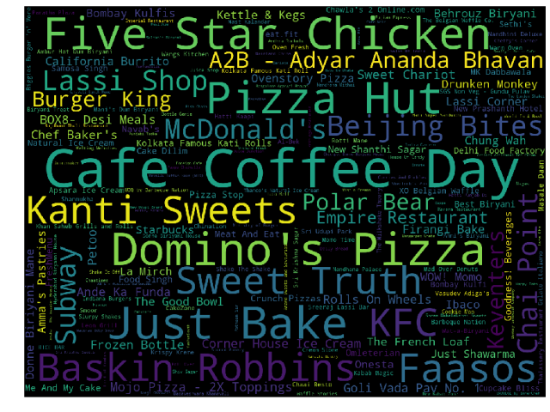
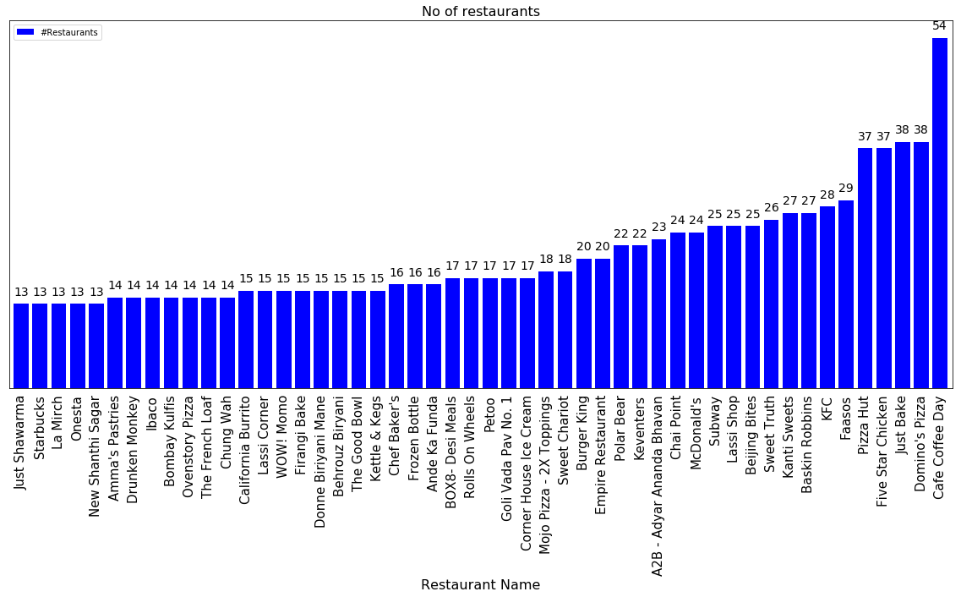
Number of food chains in Bengaluru

Slide 6
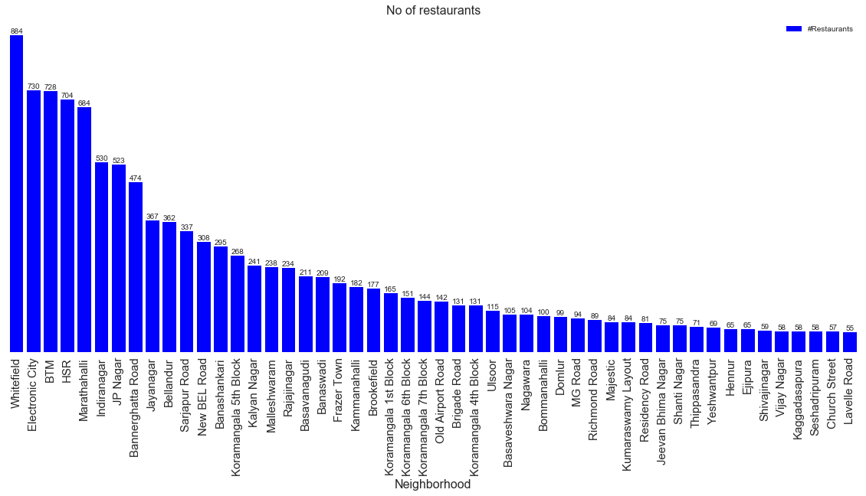
Number of restaurant in each neighborhood

Slide 7
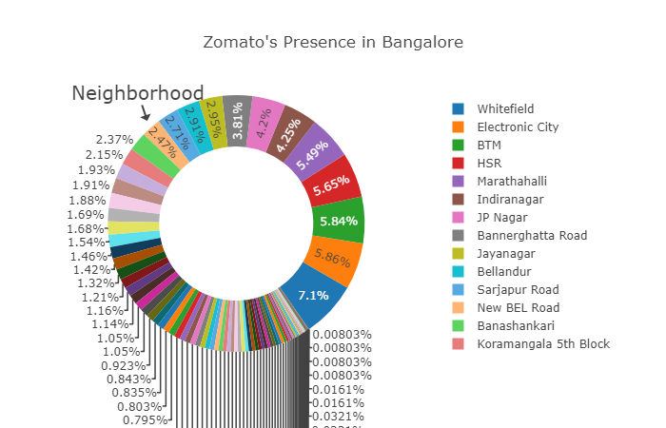
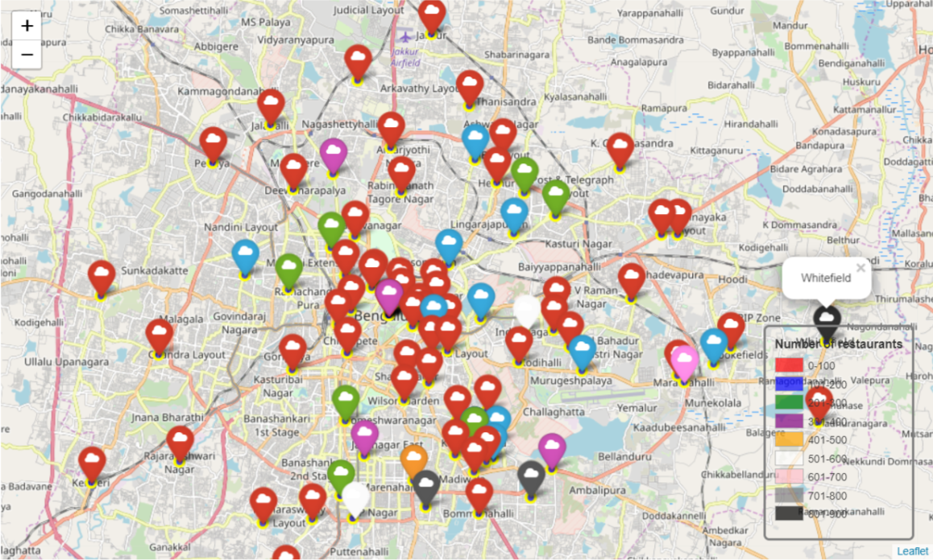
Central Bengaluru is densely populated

Slide 8
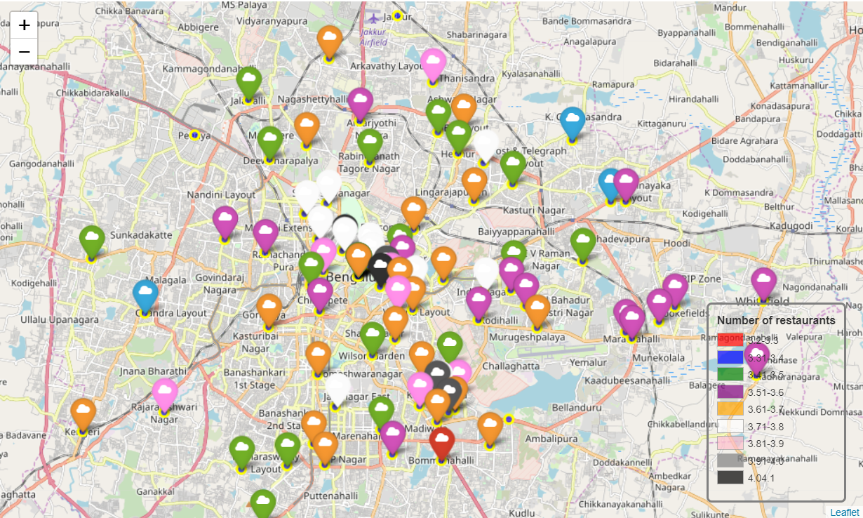
Top rated restaurants are also clustered around Central Bengaluru

Slide 9
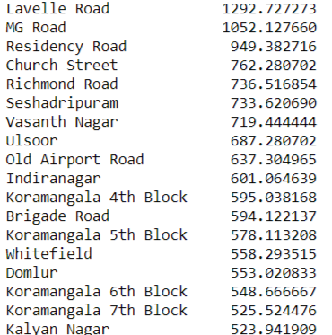
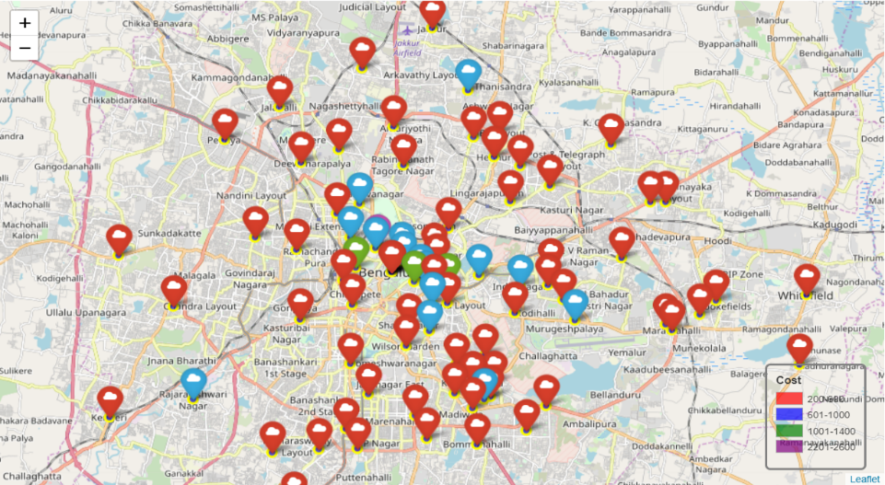
Approx cost of food by neighborhood
Cost of living in Lavelle Road is also quite high, even I can't afford the restaurants in lavelle road

Slide 10
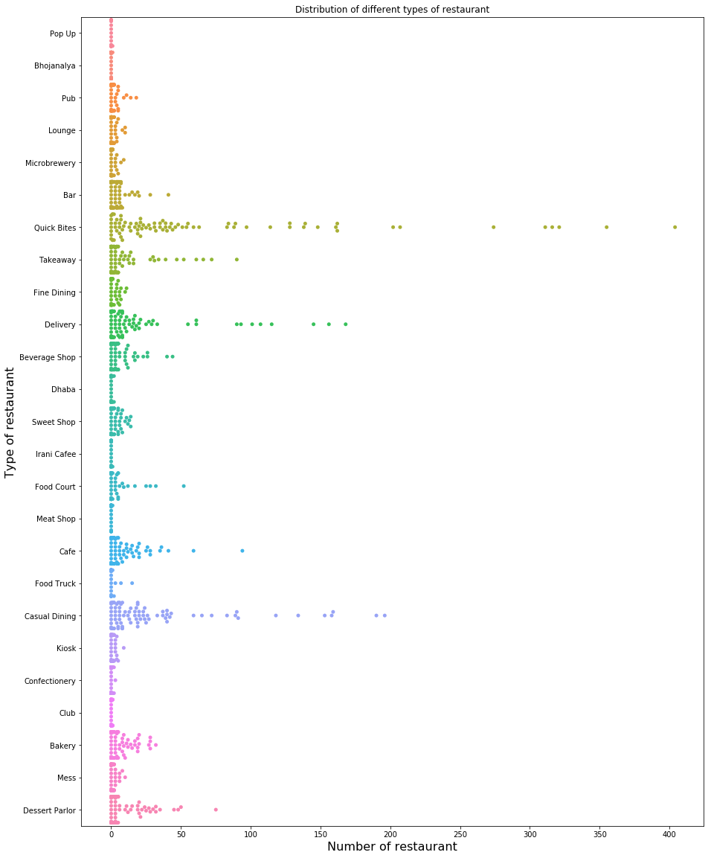
Quick Bites, Delivery, casual Dining
The population of Bangalore comprises mostly of people from 25-35 years of age. Hence delivery restaurant have to plan accordingly.
Equal weights
Different weights

Slide 11
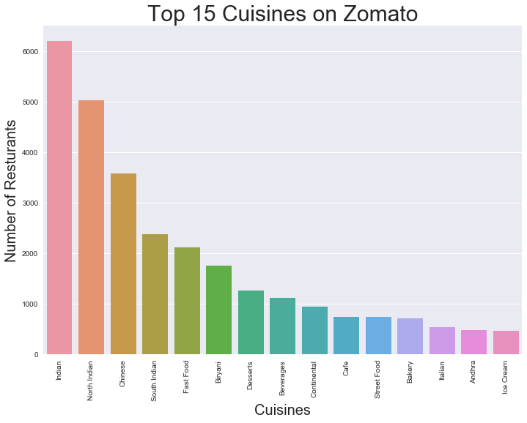
Regression models performance
Even though Bangalore is in South India but North Indian dishes are more famous here.

Slide 12
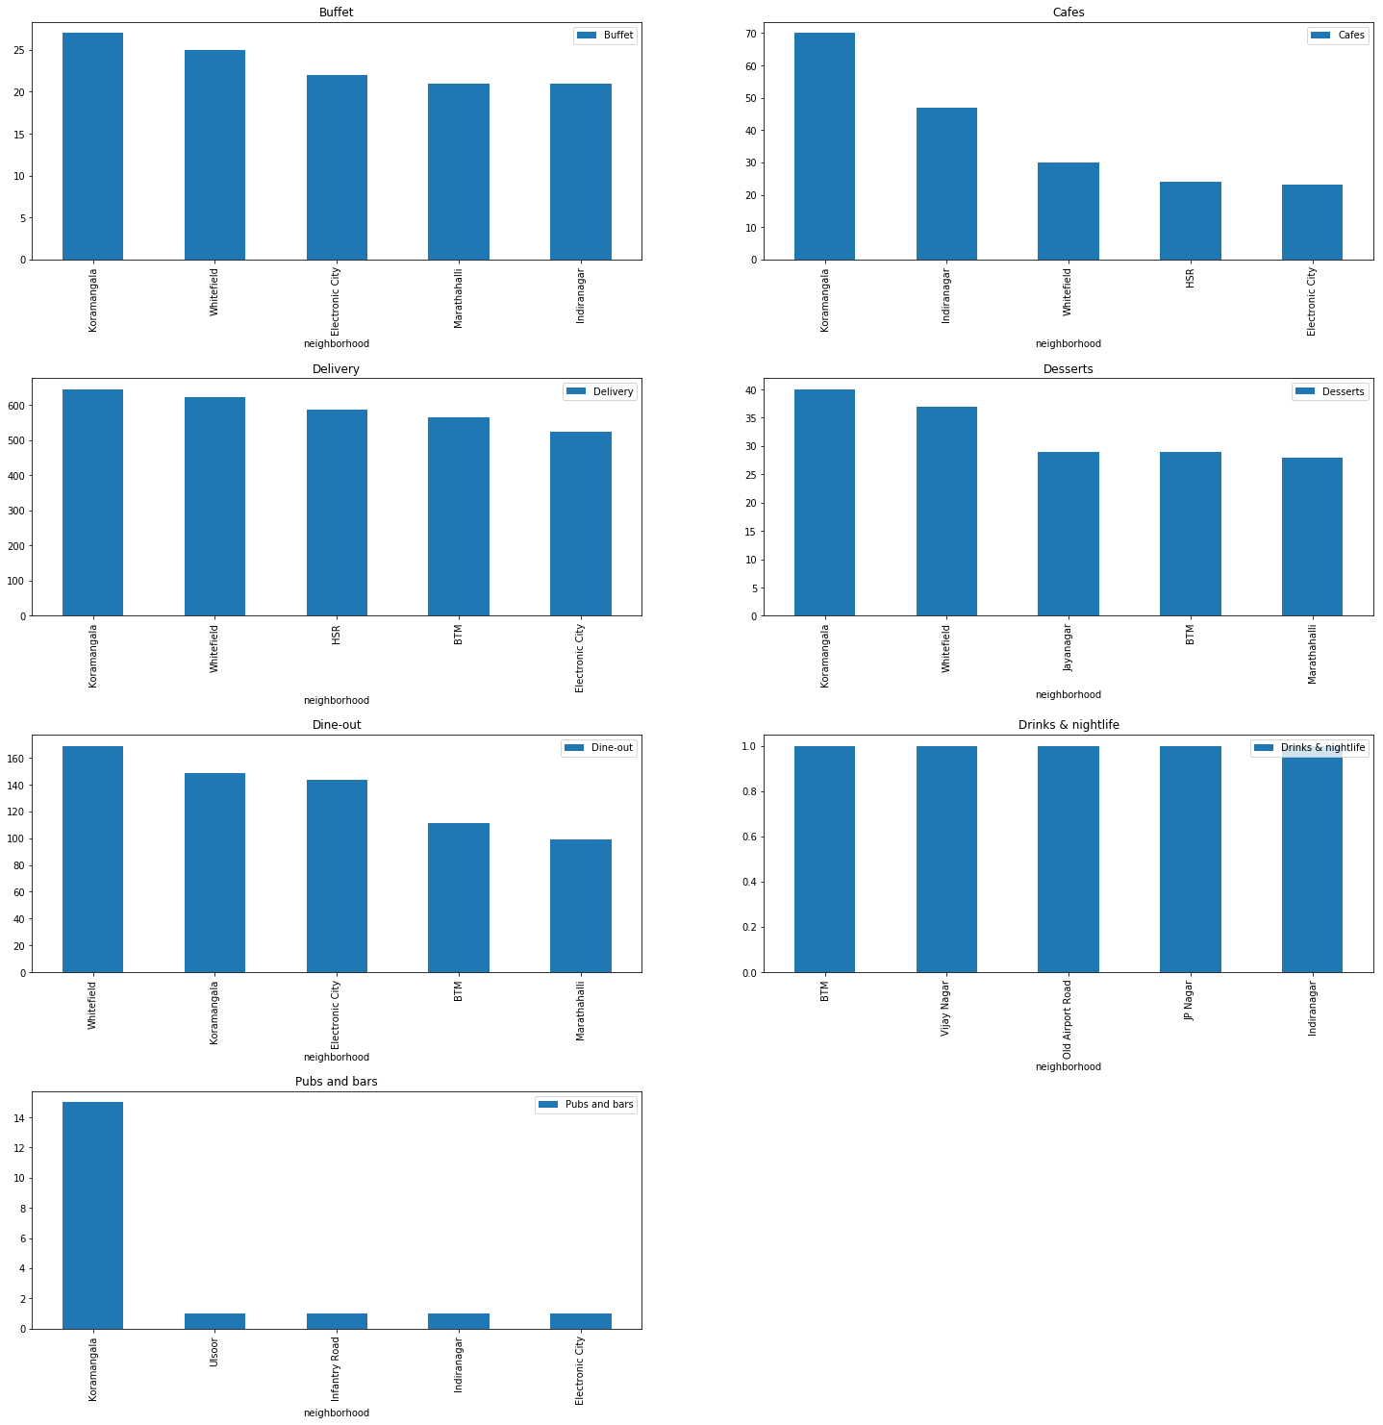
Top 5 neighborhoods by type of restaurant

Slide 13
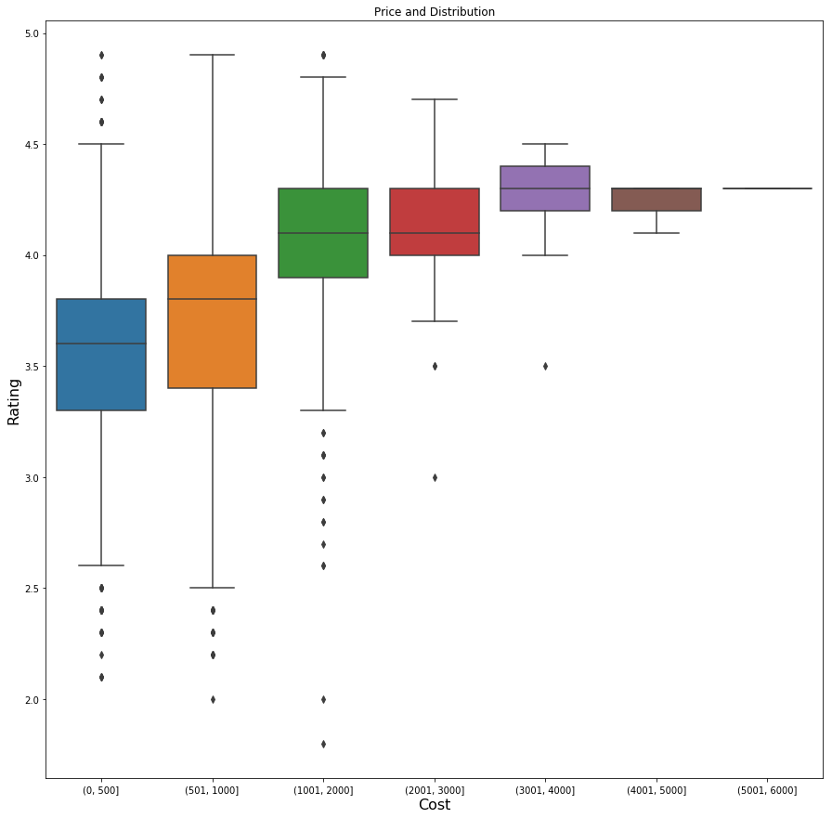
Cost increase Rating increase

Slide 14
Higher rated restaurant have more Cuisines
After analysing the data it was found that these type of cuisines were very highly rated Goa, Seafood, Korean, African,Fast Food, Biryani, Chinese, Continental, Thai, Sushi, Sindhi, Portuguese, Turkish, Naga, Jewish, Rajasthani, BBQ, Sandwich, Momos, Andhra, Steak, Tex-Mex, Arabian, Rolls, Healthy Food, Desserts, Finger Food, Pizza, Vietnamese Italian, Mediterranean, Kebab, American, Japanese, Mexican, Indonesian, Burmese, European, French, Malaysian, Asian, Mughlai, Burger, Iranian but among these American, Italian, Pizza, Biryani, Continental, Chinese, Seafood, Korean were much highly rated. Though North Indian, South Indian, Ice Cream, Mangalorean Beverages, Street Food, Cafe, Indian were the top rated but it is quite obvious for such type of restaurant to be at the top.

Slide 15
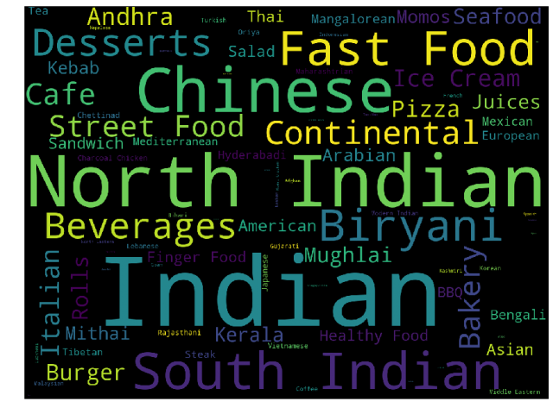
Famous cuisines in Bengaluru

Slide 16
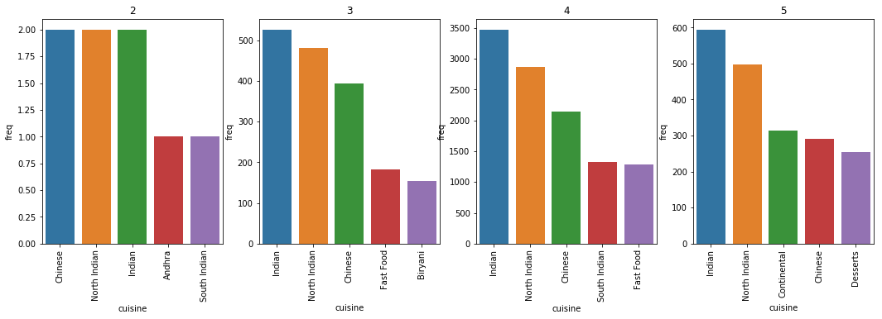
Foreign Cuisines are highly rated

Slide 17
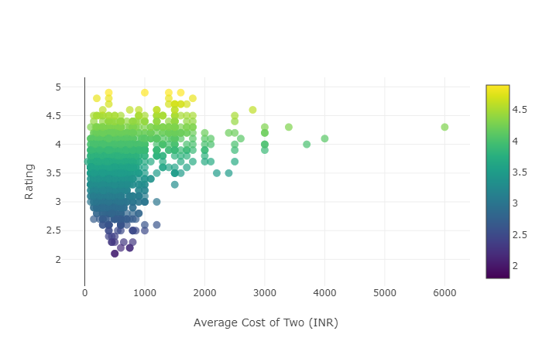
Rating and cost
Pearson correlation. Null Hypothesis : There is no relationship between the rating and price of the restaurant Alternate Hypothesis : There is some relationship between the two.
P-value of: 3.59519e-228
Reject our NULL hypothesis. There is some relationship between the two

Slide 18
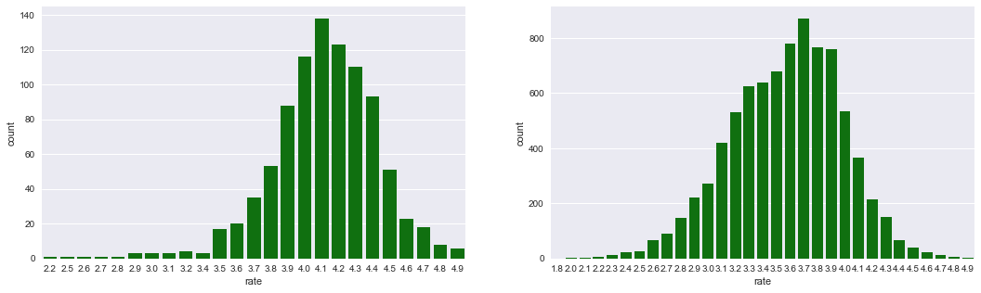
Restaurants that offer Table booking option were rated higher
Yes, Table book option restaurants are rated higher.

Slide 19
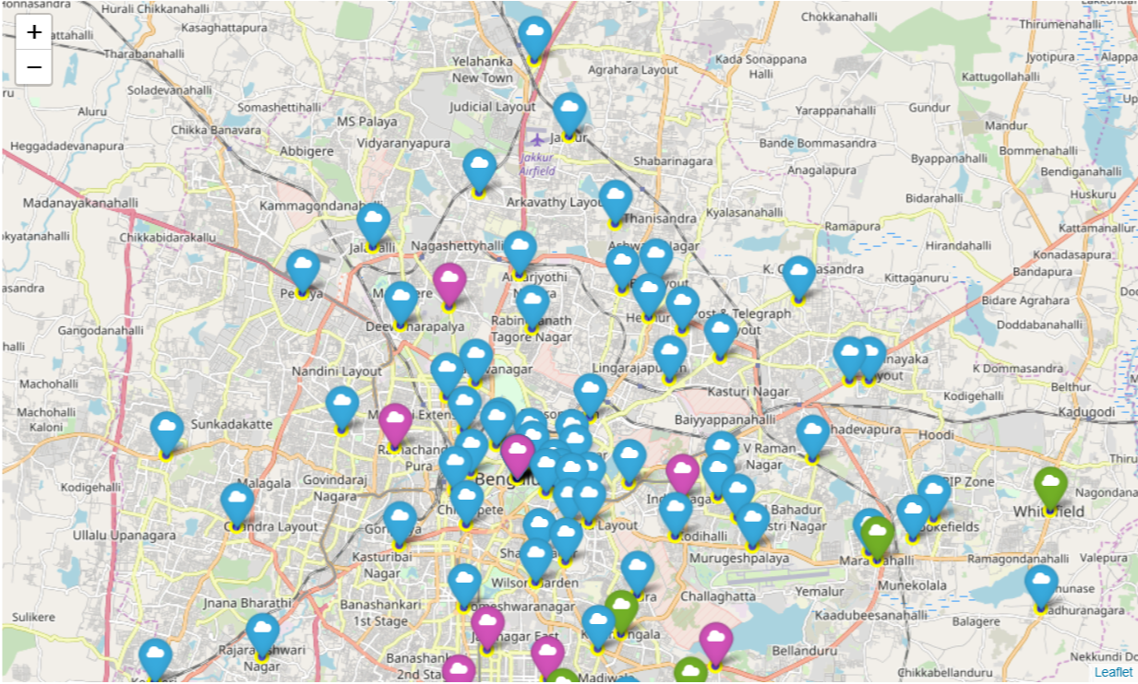
K-means Clustering based on Type of Restaurant
Cluster 1 or those marked in Blue are the places that are more famous for its Biryani, Chinese, Fast food and North Indian food.
Cluster 2 or those marked in Green are those places that are more famous for its South Indian, Indian, North Indian, Chinese as well as fast food.
Cluster 3 or those marked in Purple were those areas where Street Food, Chinese, Fast food were more popular or we can say more number of restaurants were present.

Slide 20
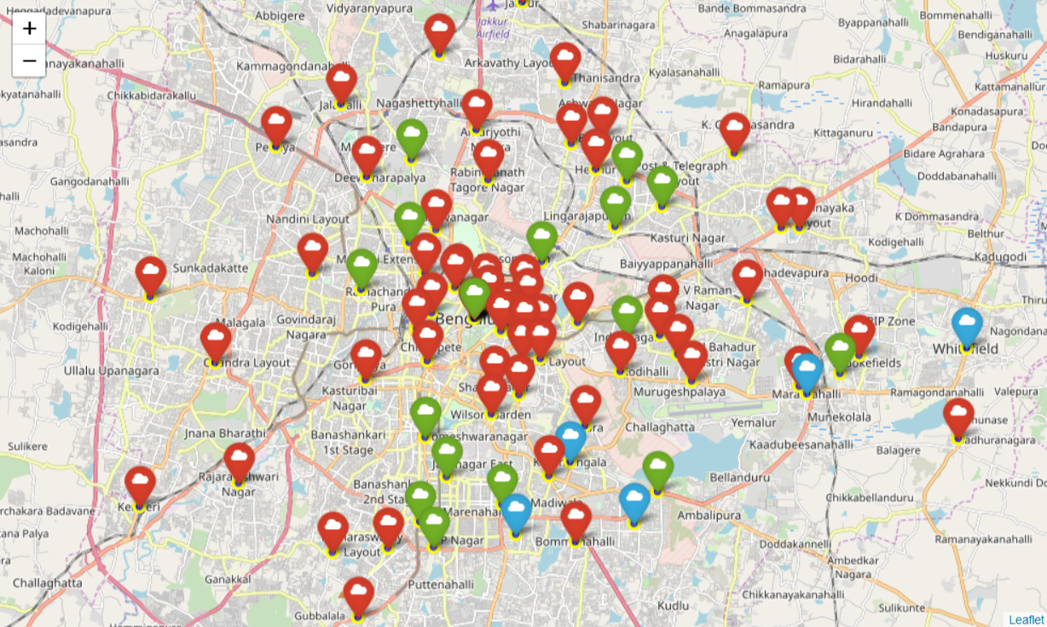
Clustering of neighborhood based on Cuisines
Cluster 1 that are marked in red are generally residence(only) areas of bangalore. There aren't much nighlife, pubs, bars in those areas
Cluster 2 marked in Blue are the hubs of restaurant in Bangalore, After verifying it with the ground truth it was found that new foreign food chain starts its operation from these places only.
Cluster 3 marked in green contains most of the posche areas of Bengaluru, they contain both residence as well as costly restaurants of Bangalore.

Slide 21
Conclusion and future directions
Quick service restaurants are a mainstay of the Indian food service market, and are growing fast. Fine dining is gaining prominence too. Both multi-cuisine and single-cuisine establishments have shown tremendous growth.
The model and the idea can be used in real life if I get the access to the ordering data of Zomato.
Telling certainly about entire neighborhood which is really large is not possible. But the taste of a locality can be found out by their ordering pattern and the type of restaurant it houses.
Cafe Coffee day has its outlet in most of the neighborhood of Bengaluru. The Indian food service market has come a long way from the early Nineties when it was dominated by unorganised players and few brands.
These pattern can be mined from the data which is seen in the real life too. Thanks to the diversity of India. The data can also be used to find out the popular food, type of people, residency area etc to help new restaurants take better data driven decisions.

